Slide 1


January 17th, 2026

Slide 2

2026 Theme:
Knitted Together

Slide 3


Slide 4

Activity: Stand-Up If

Slide 5
Stand Up If...
You're feeling tired this morning?
You've ever been in a car accident?
You like to sing in the shower?
You prefer board games to card games?
You know the song Let It Go form Frozen?
  Sing the chorus
You have a favorite superhero?
You are younger that 40?
You wear glasses of contacts?
You have been kicked out of a restuarant or store?
You have thrown up on or after riding a rollercoaster?
You know how to ride a bike?
You can name all 50 states?

Slide 6

Ministry Highlights

Slide 7
Ministry Highlights
Mom's Connection
Enough
AMA
Celebrate Recovery
Purity Ministry
Arts and Entertainment
Kingdom Brotherhood
Intentional Fathers
Food Pantry
The Closet
Marrieds
FOCUS
Campus
Youth and Family
Children's Ministry
HOPE
Worship Ministry
Care and Compassion
Charlottetown Terrace
Benevolence

Slide 8
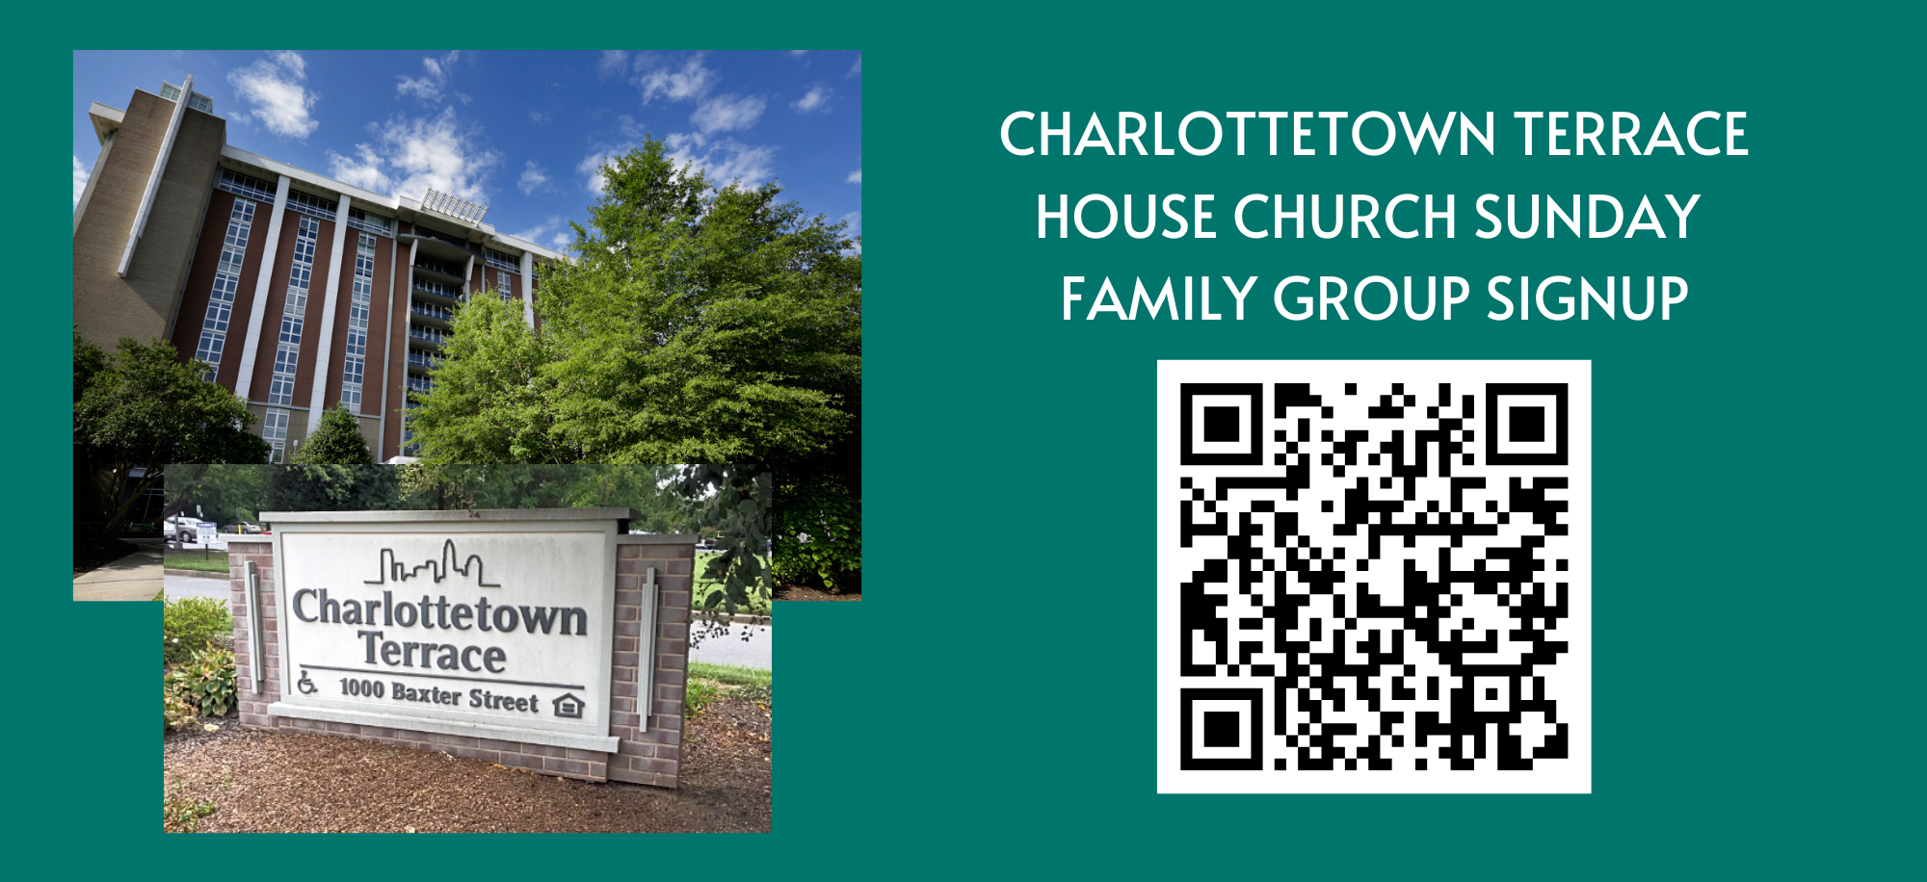

Slide 9
Lesson
Kendall Albert

Slide 10
2026 TCC Deacon Zones
Todd McLaughlin

Slide 11
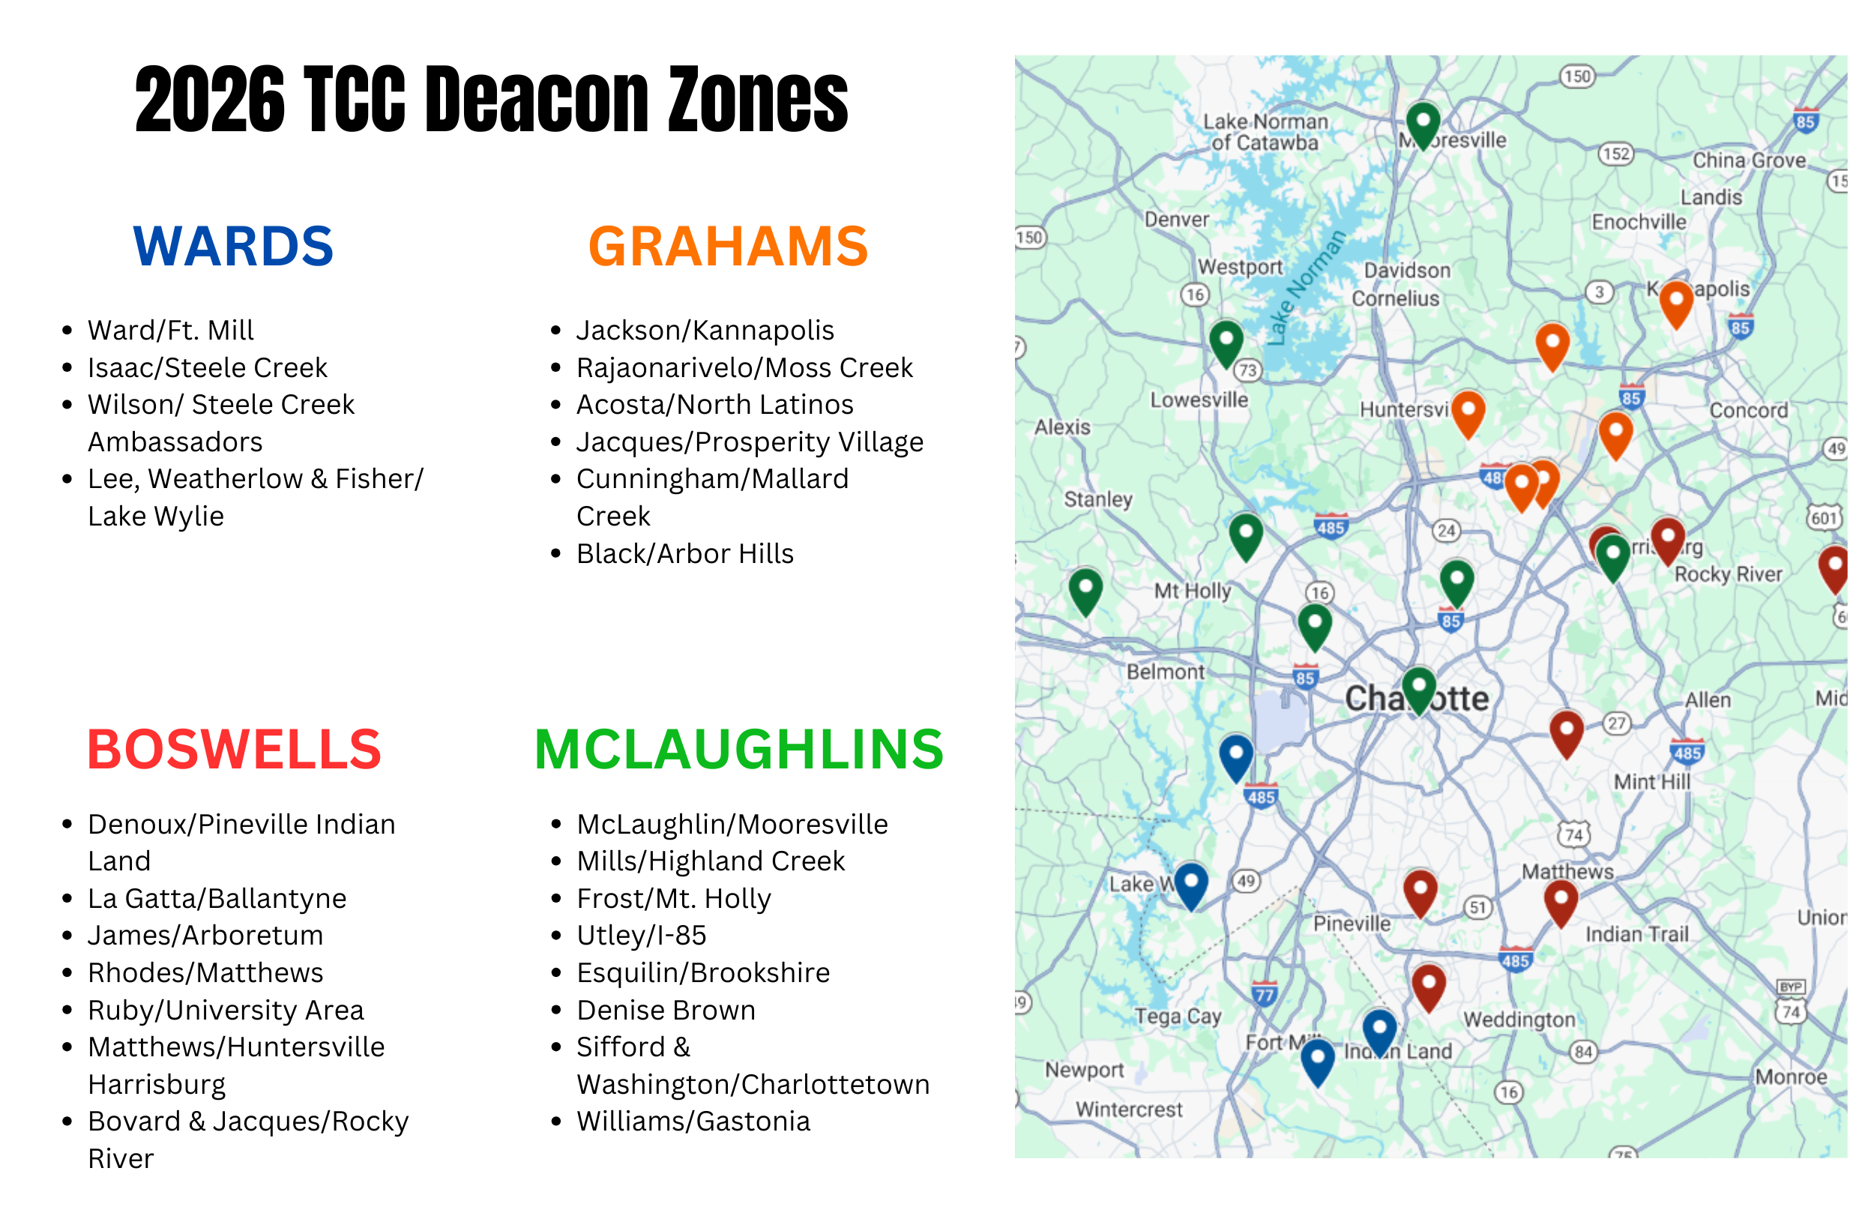

Slide 12
Zone Break Out
Roles and Expectations of Family Group Leaders
How's it going?
What support do you need?

Slide 13
Albert's Contact
Kendall
404-731-2361
Kalbert@thecharlottechurch.org
Makenzie
404-245-3447
Malbert@thecharlottechurch.org

Slide 14
THANK YOU!

