Slide 1
hopeww.org

Slide 2
Purpose
The purpose of our hurricane preparedness toolkit is to provide families and households affected by hurricanes with comprehensive and accessible information, tools, and resources that empower them to navigate the challenges and uncertainties brought on by such events. Our toolkit aims to be a trusted companion, offering practical guidance on emergency preparedness, immediate response strategies, and step-by-step recovery processes. We are dedicated to equipping families with the knowledge they need to make informed decisions, access vital services, and effectively coordinate efforts with local authorities and community organizations. By consolidating a wide range of disaster-related information in one place, our purpose is to alleviate stress, promote resilience, and help affected families regain a sense of control and stability amidst challenging circumstances.

Slide 3
When Disaster Strikes!
A Hurricane Preparedness Toolkit

Slide 4
BEFORE:
Vitals steps to take prior to a hurricane

Slide 5
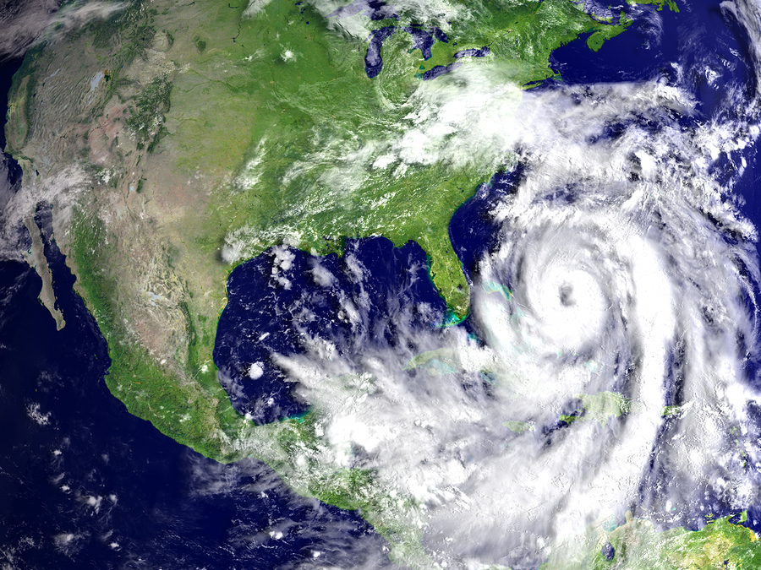
Hurricane Season
Eastern Pacific:
Central Pacific:
Atlantic:
May 15th – November 30th
June 1st – November 30th
June 1st – November 30th

Slide 6
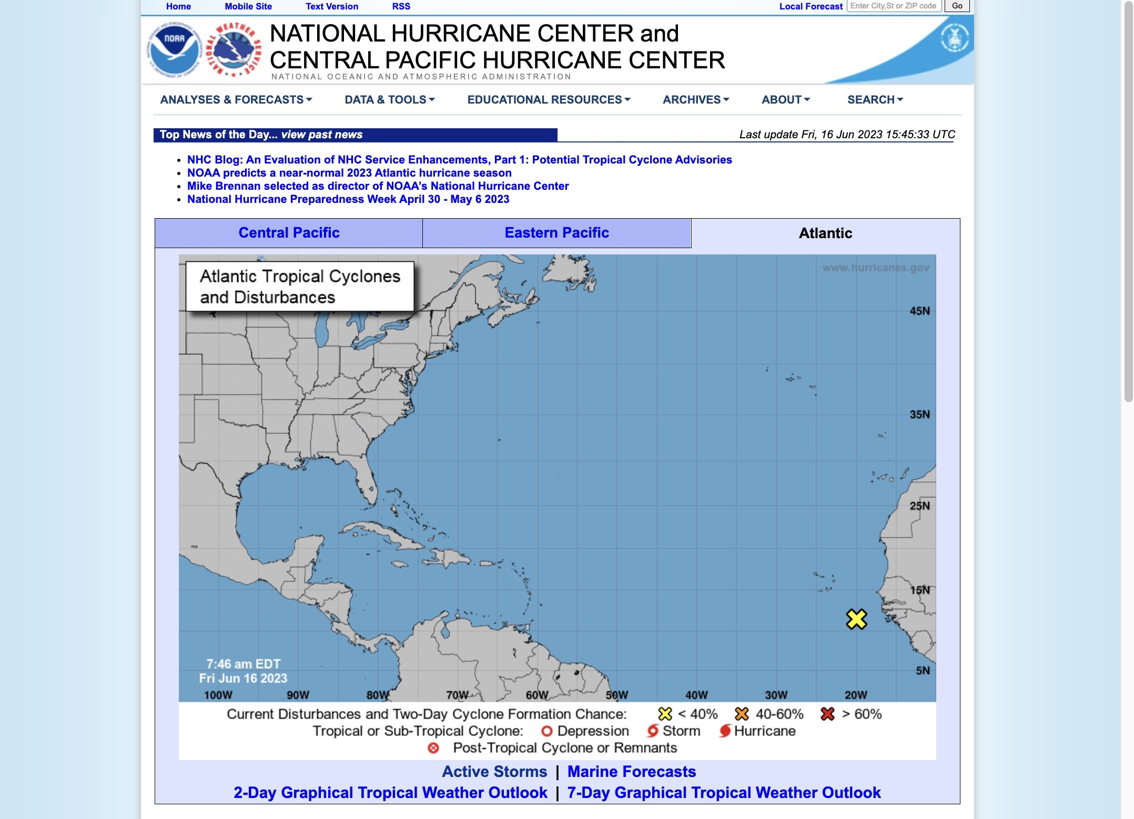
Stay Alert
When preparing for hurricane season staying alert is necessary.
Alert Websites
National Hurricane Center
National Oceanic & Atmospheric Administration
Storm Prediction Center

Slide 7
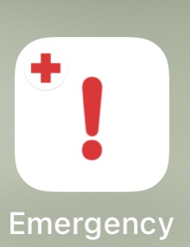
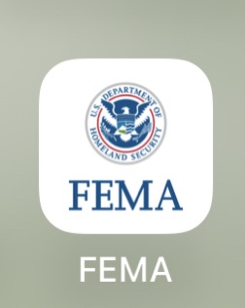
Download Apps
Help you stay up to date on all Local Alerts
Free emergency app: English/Spanish & accessible for those with disabilities
Customizable weather alerts to area
Guided steps to help individuals, families & communities be prepared
Easy access to shelter information

Slide 8
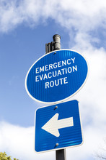
Learn Your Risks
What hazards are specific to your area?
Ex: Flood zone
FEMA’s Flood Smart Widget
Consider the demographics of your household
Age, medical issues, disabilities, animals
Consider learning first aid or joining CERT
What hazards are within you home?
Old or leaking roof
Faulty wiring or old pipes
What disaster equipment does your household need?
Learn your city’s evacuation route
HAZARD: a source of danger; the effect of unpredictable and unanalyzable forces in determining events

Slide 9
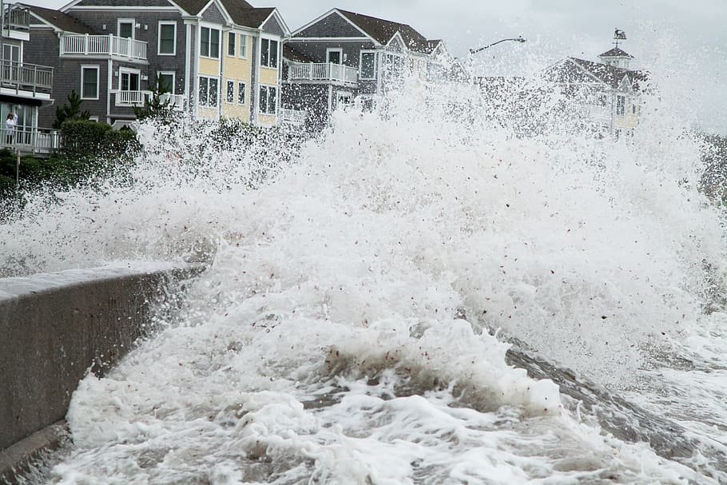
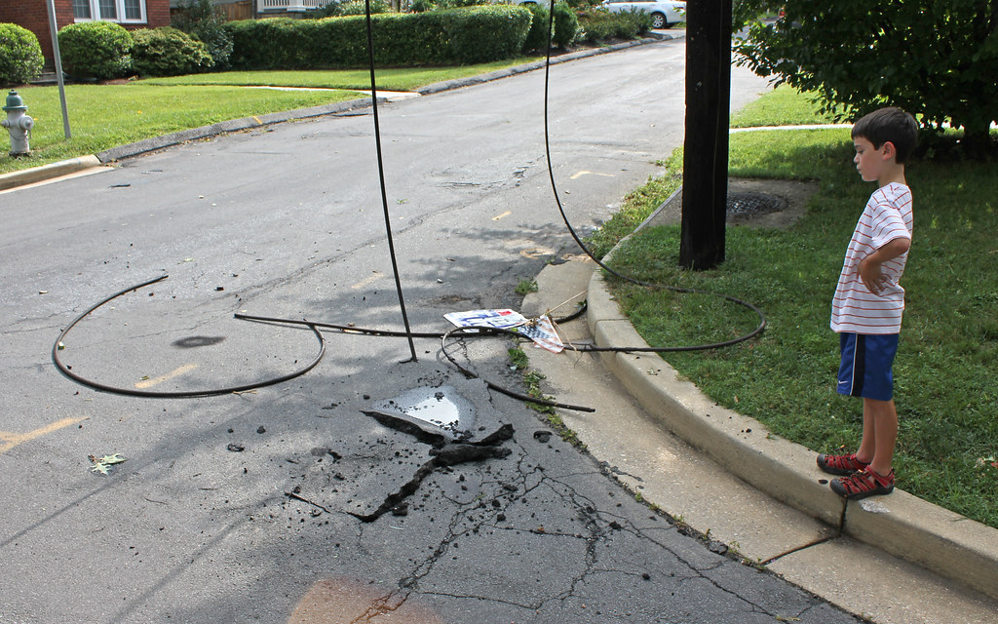
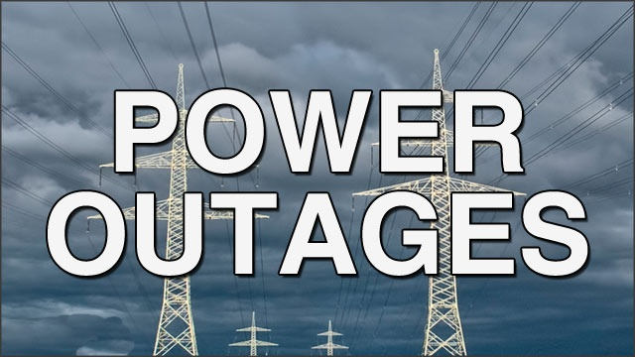
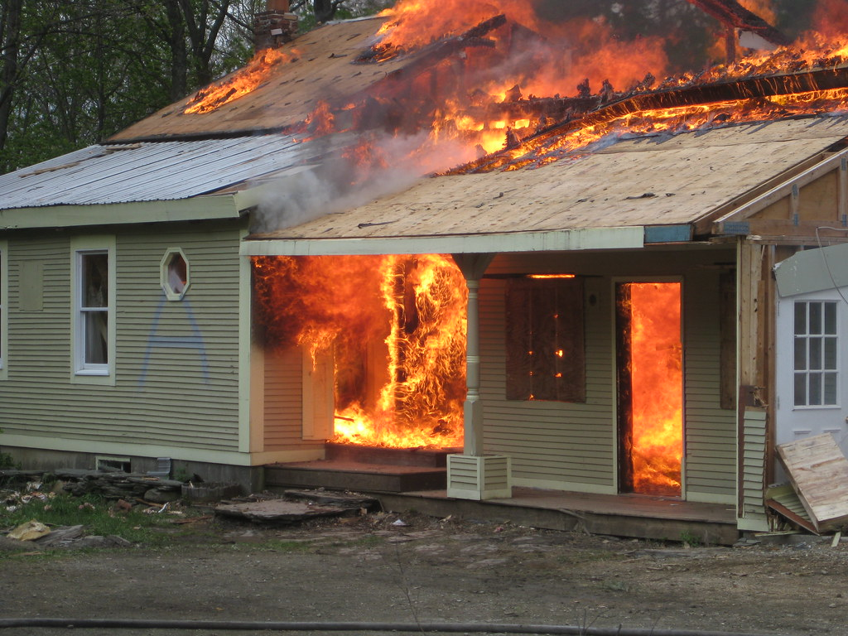
Beware of Hazards
Here is a list of potential hazards that could occur during and after a hurricane
Storm Surge Kills
Down Powerlines
Don’t Drive
House Fires
No Water

Slide 10
Create Plans
Don’t have a plan & need help visit:
Ready.gov
FEMA.gov

Slide 11
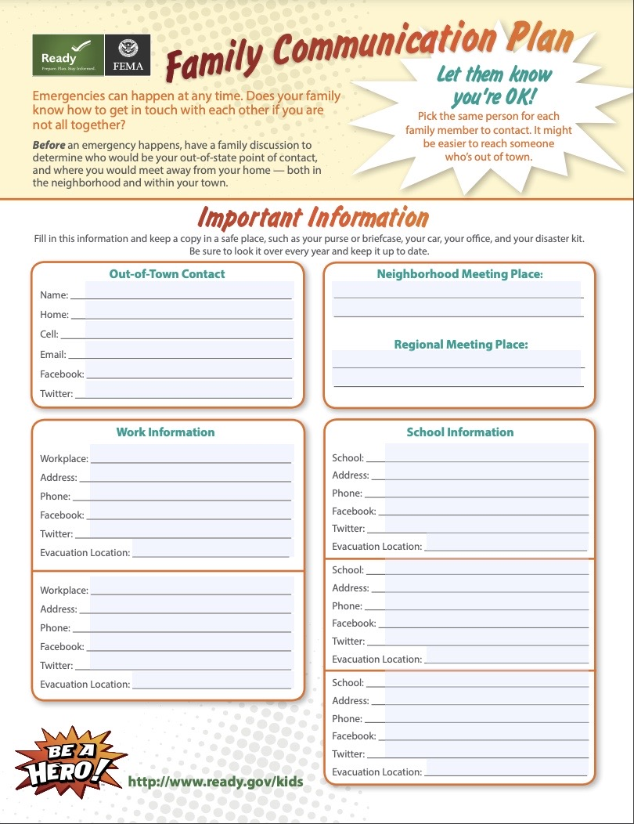
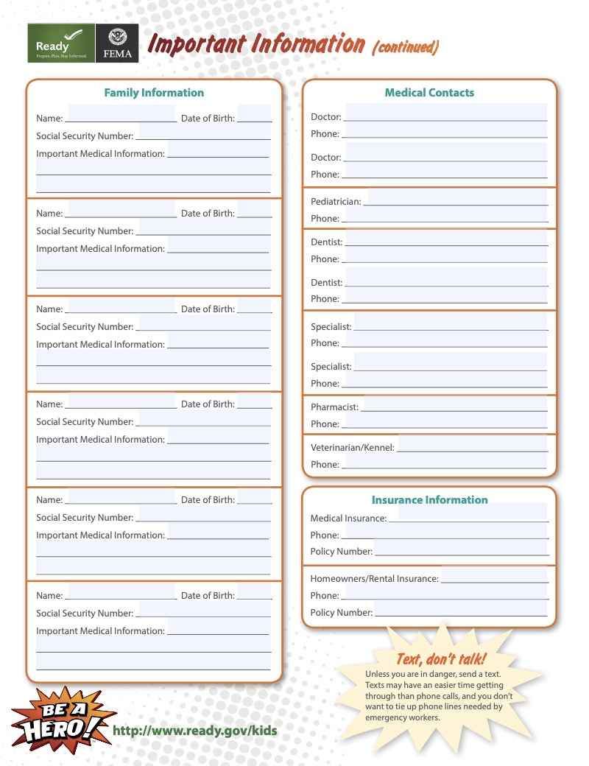
Communication Plan

Slide 12
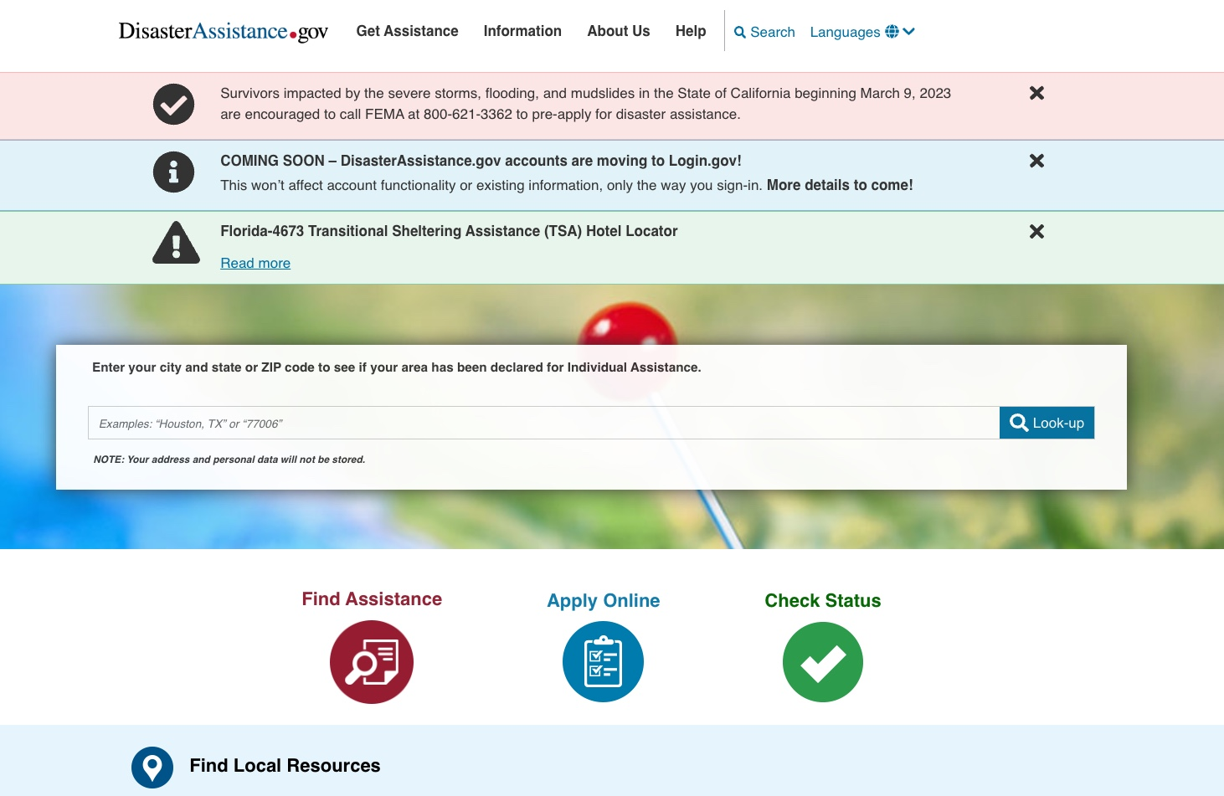
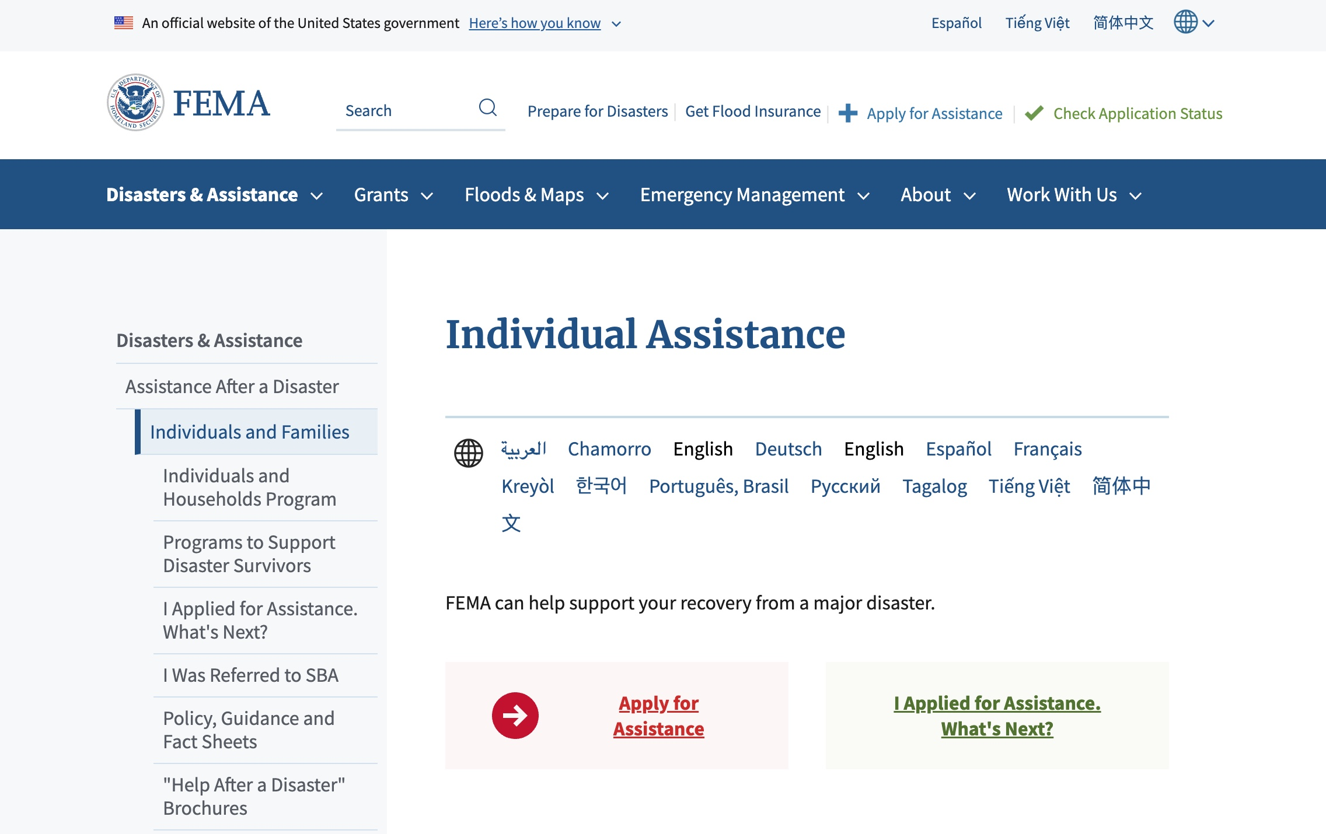
Insurance & Assistance
Educate yourself on your insurance policy
Determine if you need specific insurance coverage
EX: flood insurance
Learn how to file a claim and when to file
Learn what local organizations offer disaster financial assistance
Become familiar with federal assistance web sites
FEMA Assistance
Disaster Assistance
The Salvation Army
United Way
2-1-1

Slide 13
Start Preparing Now!

Slide 14
How to Prepare
Take alerts & warnings seriously!
Create emergency plans!
www.ready.gov/plan
Share them with your family
Prepare an emergency go bag
Buy emergency equipment
Generator, fire extinguisher, tarps, tent
Fill gas tank
Never let gas tank get below half a tank
Secure home
Hurricane shutters, tying down furniture, locking windows
Drive emergency routes
Map out different routes
Want more help with Preparing check out:
FEMA: 12 Ways to Prepare

Slide 15
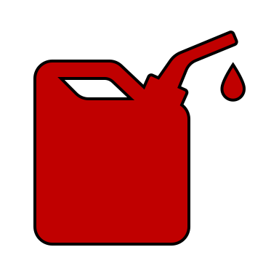
Go Car Checklist
Having a Go car is vital when evacuating
Supplying your car with these necessary items is essential when having to evacuate in short notice
Tent
Maintenance & Tools
Fire Extinguisher
Extra Gas
Flashlight
Various weather Clothing
Pet & supplies
Keep Half Tank of Gas
Emergency Roadside Equipment
Go Bag
Water
Non-perishable Food
Map

Slide 16
Go Bag Checklist
Emergency Go bag - used when an emergency occurs, and filled with necessary items to help you survive for 42-96 hours
Always include important identify documents (birth certificates, ssn, passport, home deed, rental agreement, etc)
Documents
Cell phone
Water
Batteries
Tent
Radio
Flashlight
Hygiene Supplies
Whistle
Map
Medicine
Multi-tool
Wallet
Various weather clothing
Baby Supplies
Cash
ID
First Aid

Slide 17
DURING:
How to stay safe during a hurricane

Slide 18
Get to Safety
Listen to Alerts & Updates on apps and local news
Evacuate if you can; preferably days before hurricane if possible
If unable to evacuate, please do not attempt to drive or walk through storm or in flood waters
Move away from windows
Grab emergency bag & supplies
Seek higher ground if flooding occurs
Turn off water/electric

Slide 19
AFTER
What immediate things to do after a hurricane

Slide 20
Is Everyone Safe?
Follow your communication plan
Determine if you and your household are safe before determining the safety of others
If injured determine if injuries are life-threatening, call 911 if emergent
PLEASE UNDERSTAND THAT 911 LINES WILL BE EXTREMELY BUSY
Only check on neighbors and other family members when city/county government determine area is safe
Use social media “I’m safe” feature to let people know of safety status

Slide 21
When to Seek Shelter?
Live in an apartment or mobile home with no safe rooms
If shelter is far away
Significant damage to home
Flooding from storm surge
No access to food or water
Quality of home compromises a family members physical health
IN NEED OF SHELTER
Text 44362
Prepare
Shelter
List
Call
2-1-1

Slide 22
File for Assistance
Before any demolition is completed on home
File insurance Claim
Flood
Home
Car
Apply for government or local assistance
FEMA
Disaster Assistance
Take necessary Photos
Wait for insurance to give go ahead to start demolition through volunteers
Federal assistance web sites
FEMA Assistance
Disaster Assistance
The Salvation Army
United Way
2-1-1
Search local new channels and Facebook groups

Slide 23
Citations
National Oceanic and Atmospheric Administration (n.d.). National Hurricane Center and Central Pacific Hurricane Center. National Hurricane Center. Retrieved June 16, 2023, from https://www.nhc.noaa.gov/
National Oceanic and Atmospheric Administration (n.d.). Storm Prediction Center. National Hurricane Center. Retrieved June 16, 2023, from https://www.spc.noaa.gov/

Slide 24
CONNECT WITH US
Connect with us on:
To learn more about
HOPE worldwide, visit hopeww.org.
hopeww.org

